Slide 1
GIT and Github session 4
Harshee Pitroda – SURE Trust

Slide 2
The Areas of Git
There are four important areas to be aware of when you are working with Git:
• Working directory
• Staging area
• Commit history
• Local repository

Slide 3
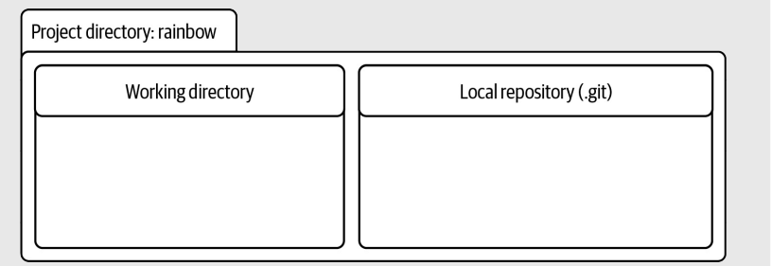
Working directory
The working directory contains the files and directories in the project directory that represent one version of a project.
ADD file
EDIT file
DELETE file/folder
In the case of the rainbow repository, the working directory is currently empty

Slide 4
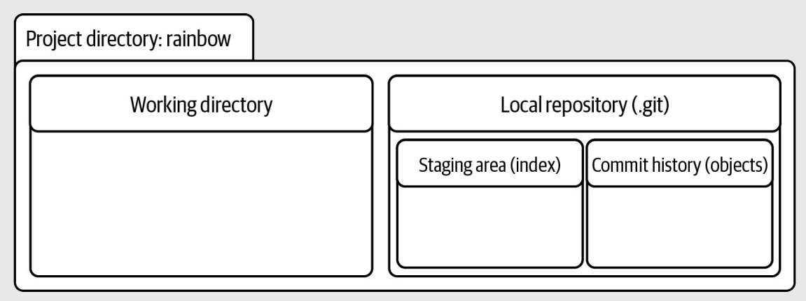
Within the local repository, there are two important areas we want to explore further: the staging area and the commit history.

Slide 5





































Staging area
The staging area is similar to a rough draft space. It is where you can add and remove files, when you are preparing what you want to include in the next saved version of your project (your next commit). The staging area is represented by a file in the .git directory called index

Slide 6
The index file is created only if you have added at least one file to the staging area in your project. In the rainbow project directory, you have not yet added any files to the staging area; therefore, the index file is not yet visible in the .git directory.

Slide 7
THANK YOU
Harshee Pitroda

